Slide 1
Geometric Sequences

Slide 2
https://www.visualpatterns.org/41-60.html
Shaded triangles in step 43: 3.2825697e+20

Slide 3
Agenda
Today, you will …
Learn how to write rules for geometric series
Practice using English to describe math processes and equations

Slide 4
Review: Vocabulary
Sequence
Term
Index
Rule

Slide 5

A New Rule
$$3, 6, 12, 24, 48, 96, 192, 384$$
The first term is $3$
Each term is the previous term times 2
What happens if I keep going?
I can simplify
$$a_{1}=3$$
$$a_{n}=a_{n−1} × 2$$
$$a_{n}=3 × 2 × 2 ×…× 2$$
$$a_{n}=3×2^{n−1}$$
Recursive
Explicit

Slide 6
Geometric Sequences
Rule: the ratio between each consecutive term is always the same
The ratio is called the common ratio, denoted $r$
$$3, 6, 12, 24, 48, 96, 192, 384$$
x2
x2
x2
x2
x2
x2
x2
In this example, the common ratio is 2

Slide 7
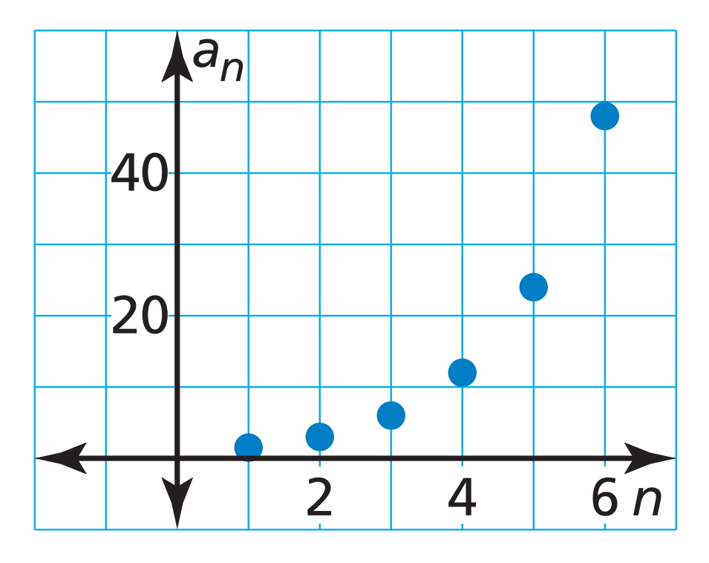

Rules for Geometric Sequences
Recursively:
$$a_{1}=…$$
$$a_{n}=a_{n−1} × r$$ Explicitly:
$$a_{n}=a_{1}(r^{n−1})$$
Geometric sequences are exponential
What kind of function is this?

Slide 8
Arithmetic vs Geometric Sequences
 | Arithmetic Sequence | Geometric Sequence
Repeated … | Addition | Multiplication
Has a | Common Difference, $d$ | Common Ratio, $r$
Recursive Rule | $$a_{n}=a_{n−1}+d$$ | $$a_{n}=a_{n−1}×r$$
Explicit Rule | $$a_{n}=a_{1}+\left(n−1\right)d$$ | $$a_{n}=a_{1}(r^{n−1})$$
Kind of Function | Linear | Exponential

Slide 9

Finding Rule from Terms
Find a rule for the sequence $5, 15, 45, 135$
$$a_{1}=5$$
$$a_{n}=a_{n−1}×3$$
$$a_{n}=5×3×3×…×3$$
$$a_{n}=5(3^{n−1})$$

Slide 10
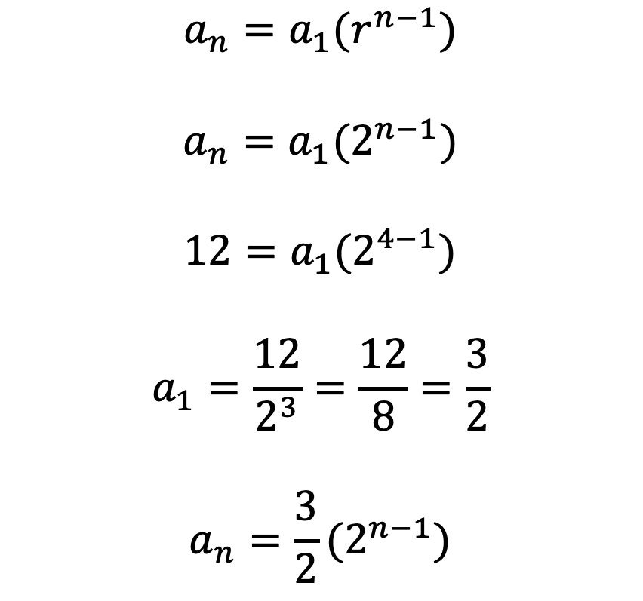
Rule from Term and a Common Ratio
One term of a geometric sequence is $a_{4}=12$.
The common ratio is $r=2$.
Write a rule for the $n^{th}$ term
$$a_{n}=a_{1}(r^{n−1})$$
$$a_{n}=a_{1}(2^{n−1})$$
$$12=a_{1}(2^{4−1})$$
$$a_{1}=\frac{12}{2^{3}}=\frac{12}{8}=\frac{3}{2}$$
$$a_{n}=\frac{3}{2}(2^{n−1})$$

Slide 11

Rule from Two Terms
$$a_{n}=a_{1}(r^{n−1})$$
$$12=a_{1}r^{2−1}$$
$$a_{1}=\frac{12}{r}$$
$$−768=\frac{12}{r}\left(r^{5−1}\right)=\frac{12}{r}r^{4}=12r^{3}$$
$$r^{3}=−\frac{768}{12}=−64$$
$$r=−4$$
Two terms of a geometric sequence are $a_{2}=12$ and $a_{5}=−768$.
Write a rule for the $n^{th}$ term.
$$a_{n}=−3(−4^{n−1})$$

Slide 12
Homework
p430 #5,7,11-19 odd,23-29,41,43,45

